Slide 1
ONLINE BOOK RENTAL SYSTEM
ARNIKA VISHWAKARMA (@01367603)
KEERTHIKA UVARAJAN (@01376036)

Slide 2
SUMMARY
Booklease is a web application which enables the user to rent books from the book owner.
This application acts as a mediator between borrower and book owner.
User need to create a profile for accessing the application.
User can either be a borrower or renter.
This software provides the facility to lend books with a very cheaper price.

Slide 3
KEY CAPABILITIES
Renting prices are cheaper.
Search books of all categories.
Book owners can update the current status of the book.
Displays the profile of the book renters and book borrowers.
Displays the books borrowed by the user.
Book owners can view the history of books rented.
This software enables the user to provide feedback.

Slide 4
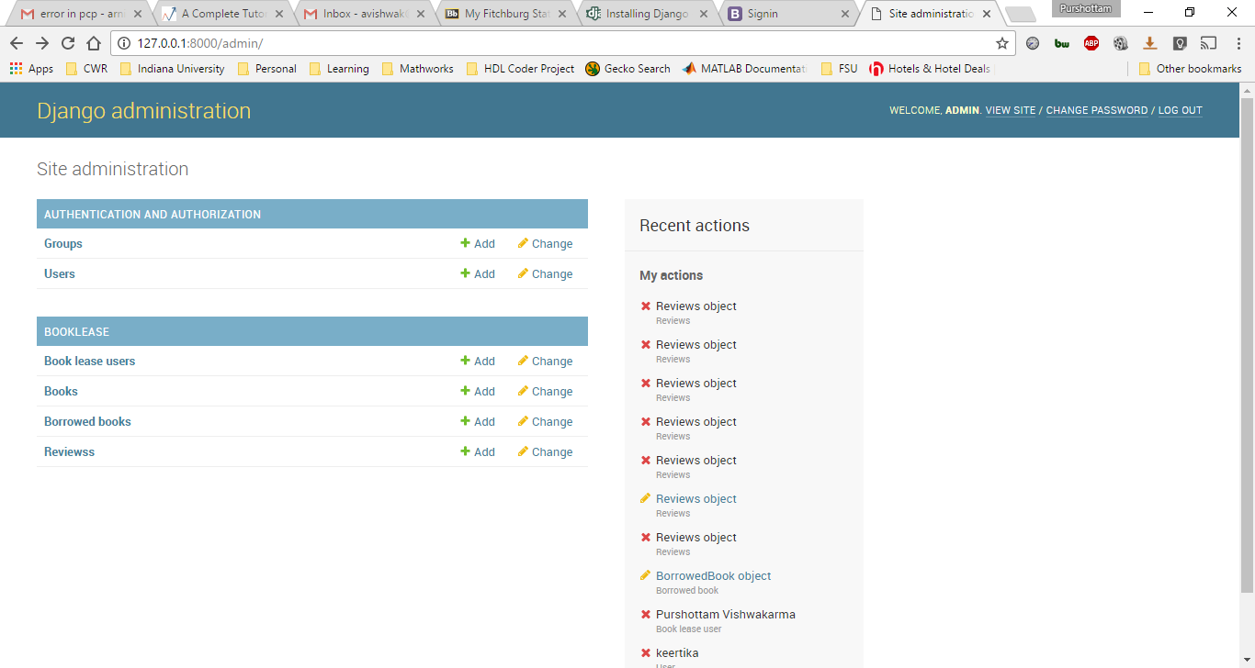
Django Admin page

Slide 5
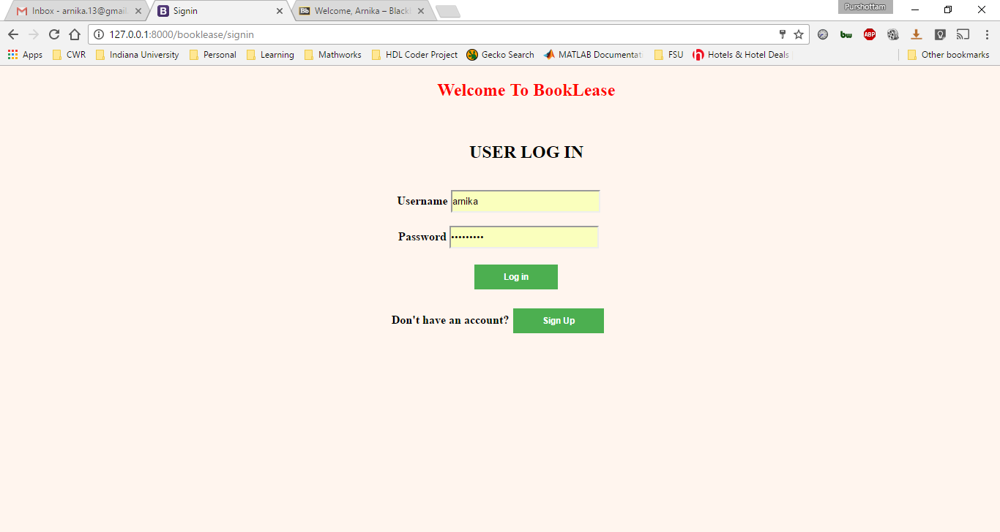
Booklease Sign In Page

Slide 6
VERIFICATION MATRIX
INDEX | NO. OF REQUIREMENT | BRIEF DESCRIPTION | IMPLEMENT | VERIFICATION
1 | [3] | Cost Cutting scheme | Yes | Null
2 | [4] | Time Consuming methodology | Yes | Manual testing
3 | [5] | No payment system | Yes | Manual testing
4 | [6] | User provide reviews to other users | Yes | Manual testing
5 | [7] | Users Detailed profile | Yes | Manual testing
6 | [8] | Points redeem system | No | Manual testing
7 | [9] | Adding Book | Yes | Manual testing
8 | [10] | Search Book | Yes | Manual testing
9 | [11] | Delete Book | Yes | Manual testing
10 | [12] | Update the Book status | Yes | Manual testing
11 | [15] | View the books borrowed | Yes | Manual testing
12 | [16] | View the account information(View profile) | Yes | Manual testing
13 | [17] | Update account information(Edit profile) | Yes | Manual testing
14 | [19] | Check the flag status on profile | No | Manual testing
15 | [20] | Provide the history of the books rented by the borrower | Yes | Manual testing

Slide 7
THANK YOU

